Slide 1




PDS
Capacity Planning & Cloud Brokers
Computer Vision
https://github.com/siagianp
https://www.youtube.com/@AmelOline/videos
https://github.com/amelcharolinesgn2/Cloud-Infrastructures
https://github.com/amelcharolinesgn2/ClouD-Infrastructure-SISKA-2025
https://github.com/amelcharolinesgn2/CCNA1
https://github.com/amelcharolinesgn2/CCNA2
https://github.com/amelcharolinesgn2/AWS Certificate
Notes:
Lab Session 01: AWS Compute Foundations – EC2, Networking, and Application Deployment Lab Session 02: Identity and Access Control with IAM Lab Session 03: Cloud Storage Solutions – S3, EBS, and EFS Lab Session 04: Database Services – RDS, DynamoDB, and ElastiCache Lab Session 05: Load Balancing and Auto Scaling Lab Session 06: Container Orchestration with ECS, Fargate, and EKS Lab Session 07: Serverless Computing with Lambda Lab Session 08: Monitoring, Logging, and Security Auditing Lab Session 09: Infrastructure as Code – CloudFormation, CDK, and Terraform Lab Session 10: CI/CD Pipelines – App Runner, CodePipeline, GitHub Actions, and CodeDeploy Lab Session 11: AI/ML Services – Rekognition, Comprehend, Translate, and SageMaker Lab Session 12: Hybrid Cloud Networking – VPC Peering, Transit Gateway, VPN, and Direct Connect Lab Session 13: Security and Compliance – AWS Config, GuardDuty, Security Hub, and KMS Lab Session 14: Disaster Recovery and Business Continuity – AWS Backup, Multi-Region, and Failover Lab Session 15: Migration and Modernization – DataSync, DMS, MGN, Containers, and Serverless
Lab Session 16: Cost Management and Optimization – Cost Explorer, Trusted Advisor, Budgets, and Well-Architected
https://www.youtube.com/watch?v=SOTamWNgDKc&t=19604s

Slide 2
Capacity Planning & Cloud Brokers
Resource Allocation, Cost Optimization, and the Cloud Broker Role

Slide 3
Overview
Key Sections:
What is Capacity Planning?
Resource Allocation in Cloud Environments
Role of Cloud Brokers
Cost Optimization Strategies
Integration of Capacity Planning & Cloud Brokers
Case Study/Examples
Challenges & Best Practices

Slide 4

Capacity Planning
Capacity planning is a strategic process that helps businesses ensure they have the IT resources to meet customer demand
Objectives:
Avoid over/under-provisioning.
Ensure scalability.
Minimize costs.

Slide 5
Key Components:
Demand forecasting.
Resource scalability planning.
Performance monitoring.

Slide 6
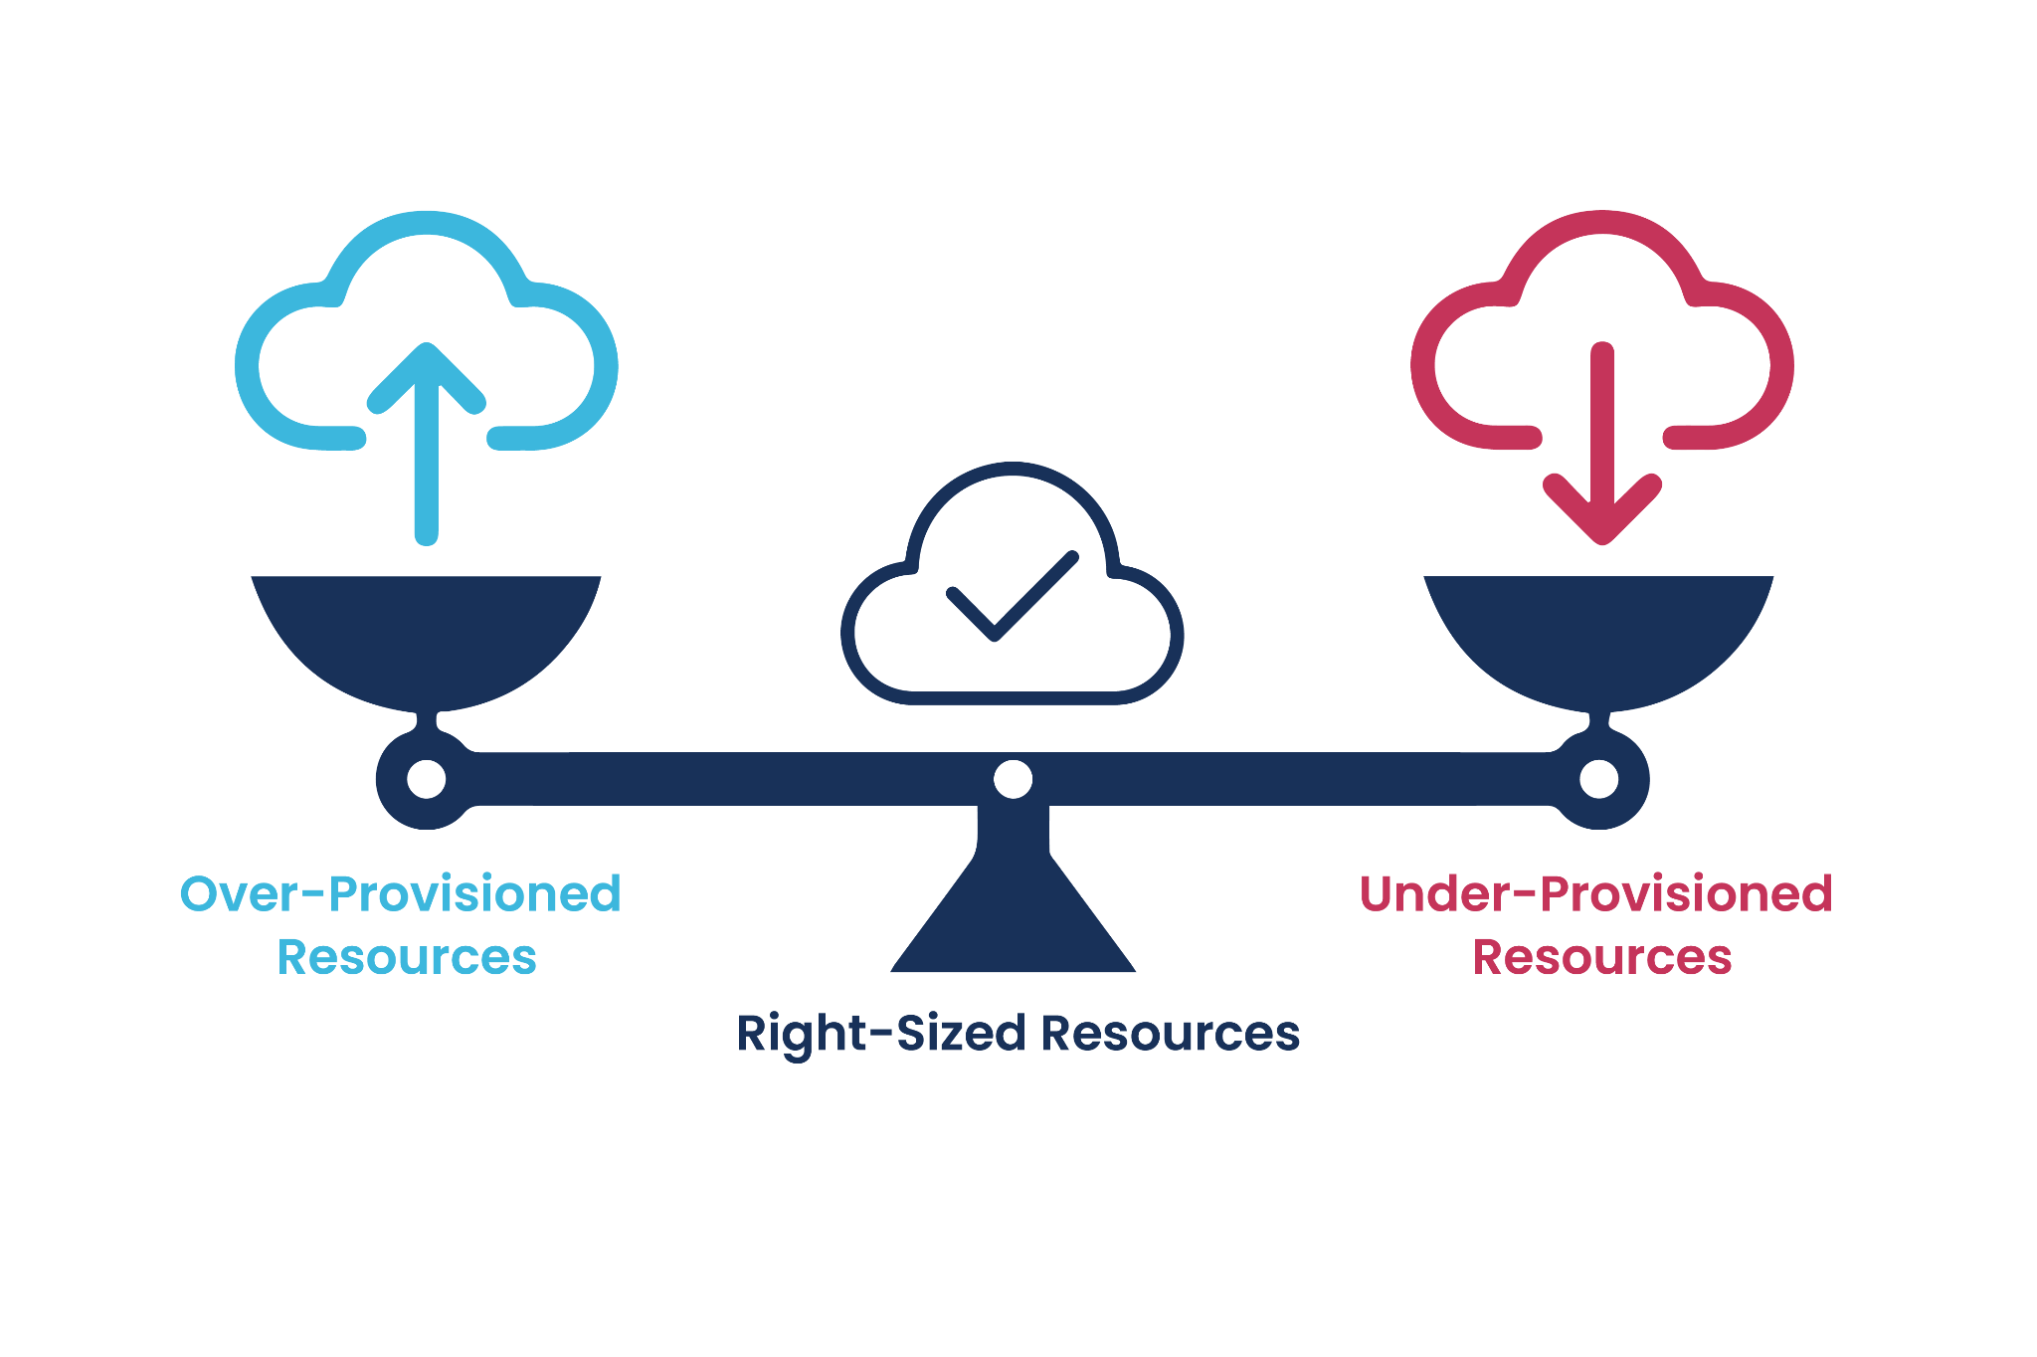
Resource Allocation in Cloud Environments
Definition: Assigning cloud resources to workloads efficiently.
Static vs. Dynamic allocation:
Static: Predefined resource allocation.
Dynamic: Adjusts based on real-time needs.
Autoscaling: AWS Auto Scaling, Kubernetes Horizontal Pod Autoscaler.

Slide 7
Challenges:
Over-provisioning (wasted costs).
Under-provisioning (performance issues).

Slide 8
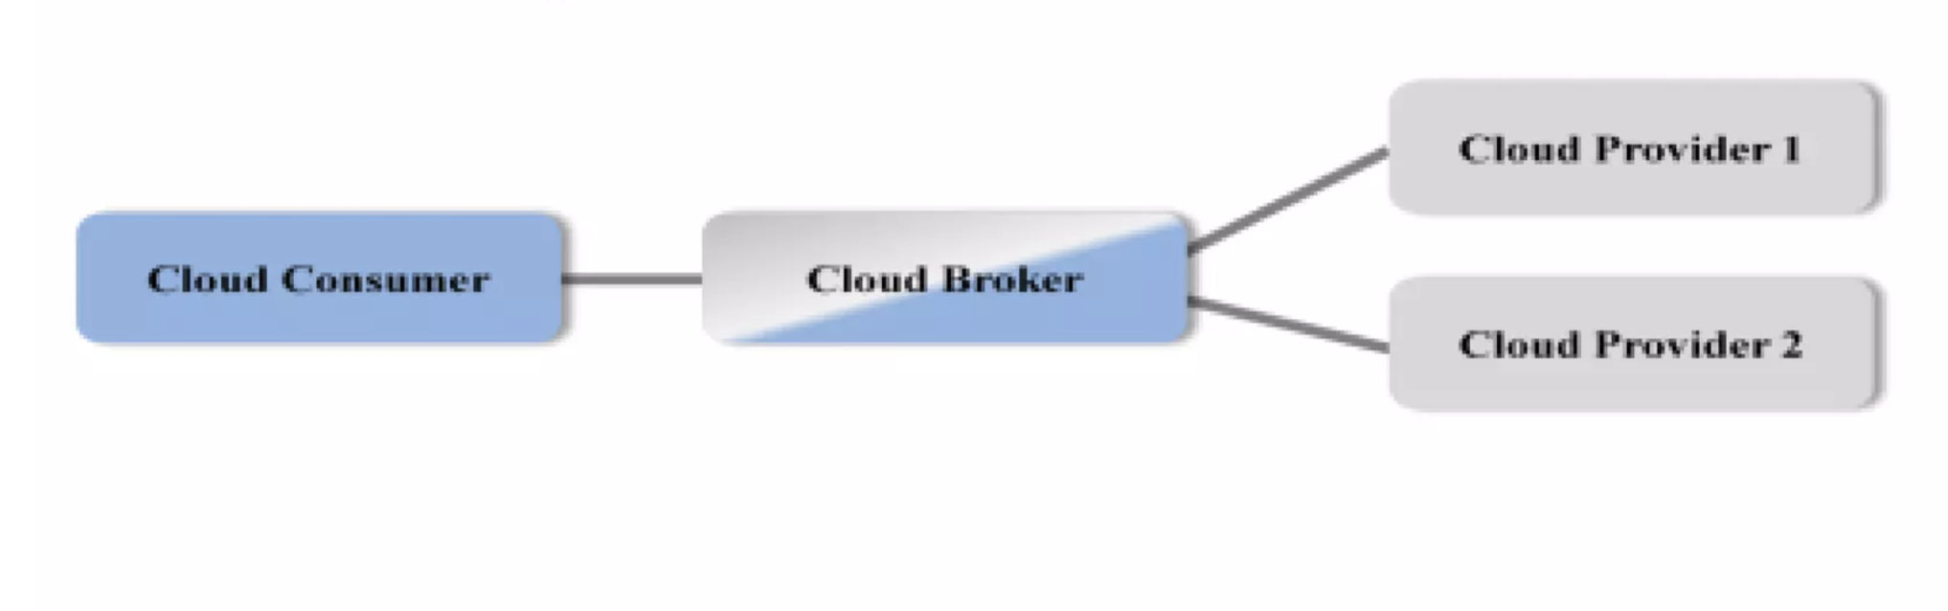
Role of Cloud Brokers
Cloud Brokers: A third-party intermediary that manages cloud services across multiple providers.
Responsibilities:
Vendor selection and negotiation.
Cost optimization through pricing analysis.
Centralized monitoring and governance.

Slide 9
Benefits:
Simplified multi-cloud management.
Reduced administrative overhead.

Slide 10
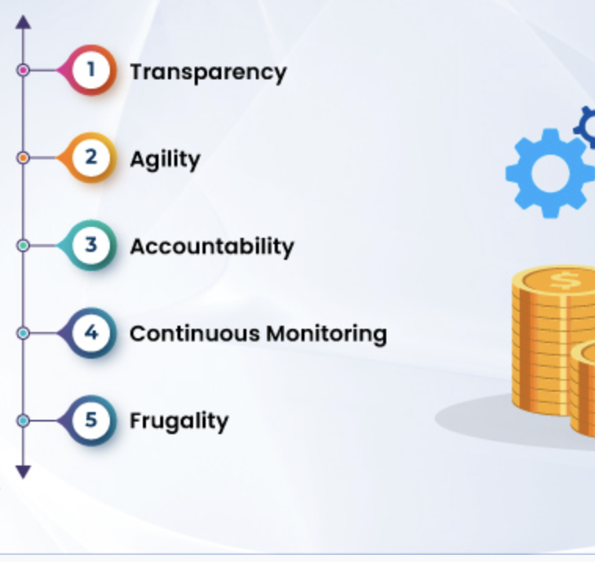
Cost Optimization Strategies
Reserved Instances: Pre-purchase discounted capacity.
Spot Instances: Use unused cloud capacity at lower rates.
Right-Sizing: Match resources to actual workload needs.
Automated Tools: Leverage AI/ML for cost analytics.

Slide 11
Challenges:
Hidden costs (e.g., data transfer fees).
Complex pricing models.

Slide 12
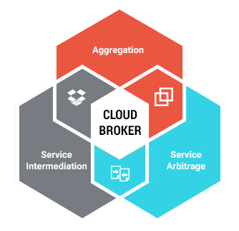
Integrating Capacity Planning & Cloud Brokers
How Brokers Assist:
Analyze historical data for accurate forecasting.
Automate resource scaling based on policies.
Negotiate better pricing with providers.
Benefits:
Reduced manual intervention.
Improved cost-performance balance.

Slide 13
Case Study/Examples
A company uses AWS EC2 with a cloud broker tool to:
Forecast peak holiday traffic.
Automatically scale resources.
Reduce costs by 30% using reserved instances.

Slide 14
Outcome:
Zero downtime during traffic spikes.
25% lower annual cloud spend.

Slide 15
Challenges & Best Practices
Challenges:
Unpredictable demand spikes.
Vendor lock-in risks.
Best Practices:
Regularly review capacity plans.
Use multi-cloud strategies to avoid lock-in.
Monitor costs with dashboards.

Slide 16
Conclusion
Capacity planning ensures efficient resource use.
Cloud brokers simplify multi-cloud management.
Cost optimization requires strategic tools and planning.

Slide 17
THANK YOU
Amel charoline
Amel Online & Irene magdalena
https://github.com/siagianp
https://www.youtube.com/@AmelOline/videos
https://github.com/amelcharolinesgn2/Cloud-Infrastructures
https://github.com/amelcharolinesgn2/ClouD-Infrastructure-SISKA-2025
https://github.com/amelcharolinesgn2/CCNA1
https://github.com/amelcharolinesgn2/CCNA2
https://github.com/amelcharolinesgn2/AWS Certificate

